Slide 1
Time Management

Slide 2
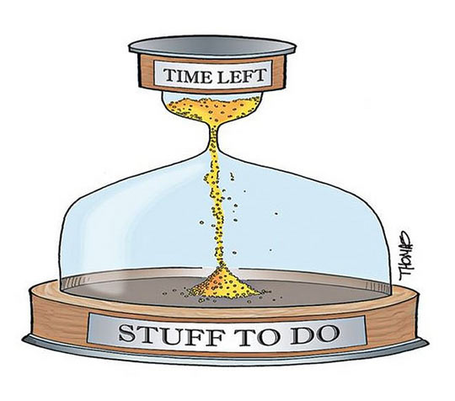
Notes:
Everyone keeps complaining that they do not have time to do anything, the reason behind this usually is Poor Time Management.

Slide 3
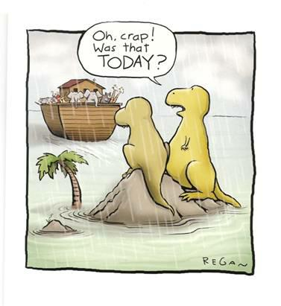
Notes:
The main reason Dinosaurs are extinct is because of poor time management. (Humour)

Slide 4
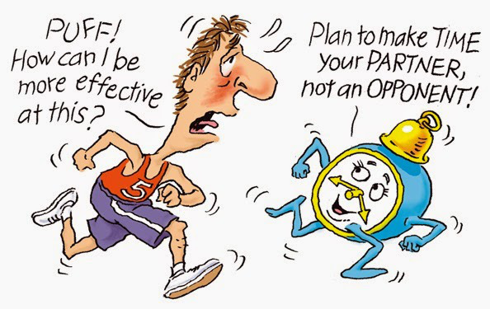
Notes:
Always try to make time as your buddy, not an opponent. You have time, you always will have, you just need to make use of it.

Slide 5
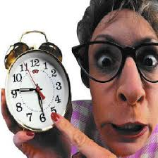
What is Time Management
“Time management is about effective scheduling of your time, goal setting, prioritizing and choosing what to do and what not to do, delegating tasks, analyzing and reviewing your spent time, organizing your workspace, keeping your concentration and focus at your work, motivating yourself to work towards a goal.”

Slide 6
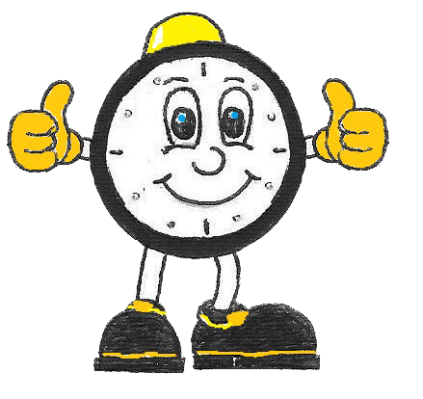
Benefits of Time Management
Less Stress
Get More Done
Less Rework
Less Life Friction and Problems
More Free Time
Less Wasted Time
More Opportunities
Improves Your Reputation
Less Effort
More Time Where it Matters
Notes:
Less Stress – Managing your time can directly reduce your stress level. Fewer surprises. Fewer tight deadlines. Less rushing from task-to-task and place-to-place.
Get More Done – Of course, being productive is one of the main goals of time management. When you are aware of what you need to do, you are able to better manage your workload. You will be able to get more (of the right tasks) done in less time.
Less Rework – Being organized results in less rework and mistakes. Forgotten items, details, and instructions lead to extra work. How often do you have to do a task more than once? Or make an extra trip because you forget something?
Less Life Friction and Problems – How often do you create your own problems? Whether it is a forgotten appointment or missed deadline, not managing your time results in increased life friction. Avoid creating your own problems by planning and preparing for your day.
More Free Time – We can’t create more time, but you can make better use of it by managing your time. Even simple actions like shifting your commute or getting your work done early can produce more leisure time in your life.
Less Wasted Time – When you know what you need to do, you waste less time in idle activities. Instead of wondering what you should be doing next, you can already be a step ahead of your work.
More Opportunities – Being on top of your time and work produces more opportunities. The early bird always has more options. As well, luck favors the prepared.
Improves Your Reputation – Your time management reputation will proceed you. At work and in life you will be known as reliable. No one is going to question whether you are going to show up, do what you say you are going to do, or meet that deadline.
Less Effort – A common misconception is that time management takes extra effort. To the contrary, proper time management makes your life easier. Things take less effort, whether it is packing for that trip or finishing up that project.
More Time Where it Matters – Managing your time is allotting your time where it has the most impact. Time management allows you to spend your time on the things that matter most to you.

Slide 7
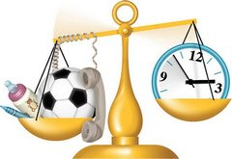
Obstacles
Unclear objectives
Disorganization
Inability to say “NO”

Slide 8
Obstacles
Interruptions
More interruptions
Periods of inactivity

Slide 9
Obstacles
Too many things at once
Stress and fatigue
All work and no play

Slide 10
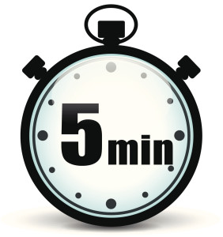
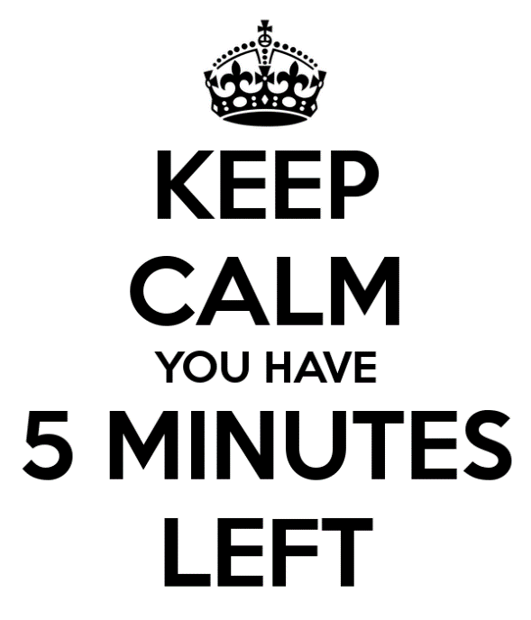
ACTIVITY – How long is a Minute?
Notes:
How long is a minute?
Cover all the clocks in the room, then ask participants to remove their wrist watches and stand up facing different directions. Instruct them to sit down when they think 5 minutes has elapsed after you shout “Start” to begin the countdown.
You will be surprised with the results. Just enjoy the fun that follows this activity. To make it more interesting I run this same activity a second time wherein I change the time to 5 minutes.

Slide 11


Key to Good Time Management
Notes:
1. Important and Urgent
There are two distinct types of urgent and important activities: ones that you could not have foreseen, and others that you've left until the last minute.
You can eliminate last-minute activities by planning ahead.
However, you can't always predict or avoid some issues and crises. Here, the best approach is to leave some time in your schedule to handle unexpected issues and unplanned important activities. (If a major crisis arises, then you'll need to reschedule other tasks.)
If you have a lot of urgent and important activities, identify which of these you could have foreseen, and think about how you could schedule similar activities ahead of time, so that they don't become urgent.
2. Important but not Urgent
These are the activities that help you achieve your personal and professional goals, and complete important work.
Make sure that you have plenty of time to do these things properly, so that they do not become urgent. Also, remember to leave enough time in your schedule to deal with unforeseen problems. This will maximize your chances of keeping on track, and help you avoid the stress of work becoming more urgent than necessary.
3. Not Important but Urgent
Urgent but not important tasks are things that prevent you from achieving your goals. Ask yourself whether you can reschedule or delegate them.
A common source of such activities is other people. Sometimes it's appropriate to say "no" to people politely, or to encourage them to solve the problem themselves.
Alternatively, try to have time slots when you are available, so that people know they can speak with you then. A good way to do this is to arrange regular meetings with those who interrupt you often, so that you can deal with all their issues at once. You'll then be able to concentrate on your important activities for longer.
4. Not Important and not Urgent
These activities are just a distraction – avoid them if possible.
You can simply ignore or cancel many of them. However, some may be activities that other people want you to do, even though they don't contribute to your own desired outcomes. Again, say "no" politely, if you can, and explain why you cannot do it.

Slide 12
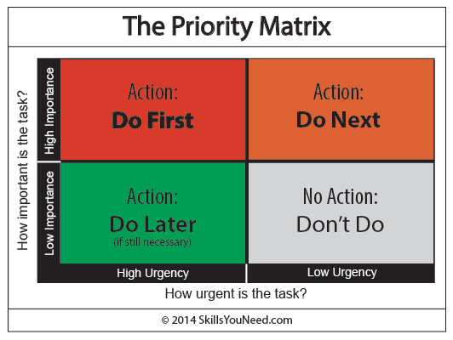
Notes:
Answering the phone is urgent. If you don’t do it, the caller will ring off, and you won’t know why they called. It may, however, be an automated voice telling you that you may be eligible for compensation for having been mis-sold insurance. That’s not important.
Going to the dentist regularly is important (or so we’re told). If you don’t, you may get gum disease, or other problems. But it’s not urgent. If you leave it too long, however, it may become urgent, because you may get toothache.
Picking your children up from school is both urgent and important. If you are not there at the right time, they will be waiting in the playground or the classroom, worrying about where you are.
Reading funny emails or checking Facebook is neither urgent nor important. So why is it the first thing that you do each day? See our page minimizing distractions to help you recognize and avoid other things that may distract you from getting your urgent and important tasks done.

Slide 13
Quadrant I - Immediate Attention Required
 | Urgent | Not Urgent
Important | I Important and Urgent | II Important, but Not Urgent
Not Important | III Urgent, but Not Important | IV Not Urgent and Not Important
Notes:
Important and Urgent Party Task:
You are having a very large party at a local venue. The day before your party, the building catches fire and burns down. You now need to immediately locate a new venue for your event. This task is important because you need a place to have the party, as well as urgent, due to the party occurring the next day. This requires your immediate attention, or the party will not be a success.
Answering the phone is urgent. If you don’t do it, the caller will ring off, and you won’t know why they called. It may, however, be an automated voice telling you that you may be eligible for compensation for having been mis-sold insurance. That’s not important.

Slide 14
Quadrant II - Requires attention, but not yet critical
 | Urgent | Not Urgent
Important | I Important and Urgent | II Important, but Not Urgent
Not Important | III Urgent, but Not Important | IV Not Urgent and Not Important
Notes:
Quadrant II – Important, but Not Urgent. (Preparations, Presentations, Planning, Relationship Building, True Recreation, Empowerment) – These should be done soon. It would be nice to do these today; but, they can be put off for a later time. If these are not completed, nothing significant will happen.
Important, but Not Urgent Party Scenario:
It is two months before your big party. You need to order invitations, and have made an appointment with the local stationary store. This is an important task, but at this time, it is not urgent.
Going to the dentist regularly is important (or so we’re told). If you don’t, you may get gum disease, or other problems. But it’s not urgent. If you leave it too long, however, it may become urgent, because you may get toothache.

Slide 15
Quadrant III -“Nice to do”
 | Urgent | Not Urgent
Important | I Important and Urgent | II Important, but Not Urgent
Not Important | III Urgent, but Not Important | IV Not Urgent and Not Important
Notes:
Quadrant III – Urgent, but Not Important. (Interruptions, some phone calls, some mail, some reports, some meetings, many proximate pressing matters, many popular activities) – There is not a set time frame. These are “nice to do” items. If these items are not done, nothing significant will happen.
Urgent, but Not Important Party Scenario:
Three days before your party, you decide that it would be really nice to have 300 handmade party favors ready for your guests. Because it is so close to your party date, this is an urgent task. However, if you do not complete this task, nothing significant will happen. You will still have a nice party, and your guests will not know the difference.

Slide 16
Quadrant IV - These activities are time eaters
 | Urgent | Not Urgent
Important | I Important and Urgent | II Important, but Not Urgent
Not Important | III Urgent, but Not Important | IV Not Urgent and Not Important
Notes:
Quadrant IV – Not Urgent and Not Important. (Trivia, busywork, junk mail, some phone calls, time thieves, “escape” activities) – These items are your time eaters.
Effective people stay out of Quadrants III and IV because, urgent or not, they are not important. They also shrink Quadrant I down to size by spending more time in Quadrant II, which is the heart of effective personal management. Our effectiveness takes a quantum leap when we start doing the things in Quadrant II on a regular basis.
You have two weeks until your party, and decide that you would like to add another food item to your menu. You already have enough food ordered, and this item is not needed. Since you have plenty of time, this is not an urgent matter. Also, if you do not add this item to your menu, there are no significant consequences, making the task “not important.”
Reading funny emails or checking Facebook is neither urgent nor important. So why is it the first thing that you do each day? See our page minimising distractions to help you recognize and avoid other things that may distract you from getting your urgent and important tasks done.

Slide 17
Urgent OR Important
Gossiping.
Closures.
Medical Emergency.
Weekly planning.
Client Call / Candidate Call.
Mindlessly surfing the web.
Playing mobile games.
.
Emails (Client/Candidate/In-house).
Client/Candidate Follow-ups.
Family time.
Girlfriend Calling.
Tracker Update.
In case of Client Escalation.
Studying.
Co-worker who comes by your desk during your prime working time to ask a favor.
Text messages of Family during work hours.
Exercising.
Scrolling through Facebook, Twitter, Instagram.
.
Phone calls of Family during work hours.
Watching TV.
Boyfriend Calling
Shopping Online.
Discussion with Team Leads.
Creating a budget and savings plan.
Notes:
Guessing Game – Urgent OR Important

Slide 18
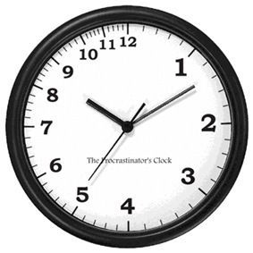
Procrastination: “Never do today what you can put off ‘till tomorrow!”
Forms of procrastination:
Ignoring the task, hoping it will go away
Underestimating how long it will take
Overestimating your abilities and resources
Telling yourself that poor performance is okay
Doing something else that isn’t very important
Believing that repeated “minor” delays won’t hurt you
Talking about a hard job rather than doing it
Putting all your work on only one part of the task
Becoming paralyzed when having to make choices

Slide 19
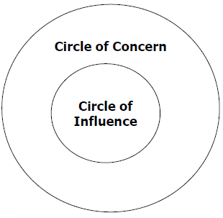
The Circles
Notes:
All of us have a wide range of concerns in our lives – our housing, our health, our friends and family, the environment, the price of a pint of beer, how to lose weight, animal rights, how to put on weight, sex and drugs and rock and roll, third world debt...
Within this whole universe of our concerns, there are some things we can influence and some things we can only stay concerned about.
Now we have a choice about where we focus our attention and energy.
We can choose to focus all our attention on the area that is outside our influence.
We can get annoyed about the shortcomings of other people, we can blame the government, global capitalism, the weather, a rotten childhood,
bad luck, or fluoride in toothpaste. This focus leads to more and more blaming and accusing, to feelings of victimization, ‘poor me’.
This negative way of thinking, accompanied by inaction to change things, results in the circle of influence shrinking.

Slide 20
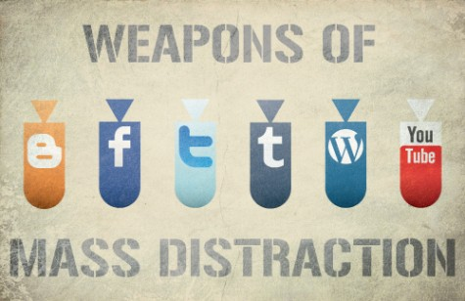
Minimizing Distractions

Slide 21
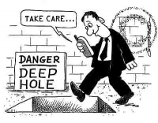
Avoiding Distractions - Phone
Silent Phone
Time to revert missed calls.
Personal/Office Mobile.
Keep call as brief as possible.
Take calls standing up.
Speed Dial – keep numbers handy.
Notes:
When you’re busy turn your phones onto silent.
Use voice-mail wisely and set aside times to return missed calls.
Schedule times in the day when you will receive calls – let others know your schedule.
Have a personal mobile phone do not give the number to your boss or colleagues. Friends and family can then still reach you in an emergency.
When making or receiving a call: be polite, listen and clarify but try to avoid excessive small talk keeping calls as brief as possible. See our pages Listening Skills and Clarifying for more information.
Take calls standing up, research shows people who stand while on the phone keep their conversations brief.
If you agree to take on tasks as part of the phone conversation act on them immediately – even if this means adding them to your ‘to-do’ list.
Store numbers that you dial frequently in your phone or keep a list readily available near the phone.

Slide 22
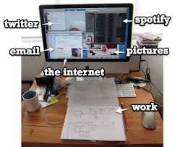
Avoiding Distractions - Email
Only open your office email .
Schedule a time for emails – start of day.
Delete Spam.
Ignore Irrelevant emails.
Forward emails – for better response.
One Email at a time.
Be wary of emails marked urgent.. they may well not be.
Notes:
Only check your emails a couple of times a day. Close your email client when it is not being used. New emails flashing up on your computer screen can be a huge distraction and time waster.
Set up folders and rules in your email client helping to automatically filter and file email messages.
Schedule a block of time each day for sending and responding to emails. Don’t let emails build up to unmanageable levels.
Delete all spam emails immediately.
Delete all irrelevant emails immediately. This includes ‘general’ emails that don’t specifically involve you. People in organizations often use the ‘Reply to All’ function in their email client. Although such emails may be relevant to certain people or departments if you are not one of them then delete.
Forward emails to somebody who can provide a better response if appropriate.
Try to handle each relevant email only once, read and respond immediately within your scheduled time. Once done file the email away.
Be wary of emails marked urgent or high priority… they may well not be.

Slide 23
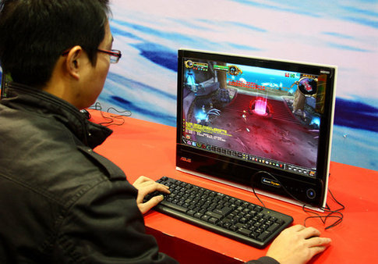
Avoiding Distractions - Computer
Disable Instant Messengers (unless its something important)
Close irrelevant documents
Close Webpages after reading
Always backup your work
Uninstall games
Notes:
· Turn off any instant messaging applications.
· Close programs and documents when you have finished using them – file your documents in a logical way. This not only removes distractions but also means your computer has more resources for doing the next job.
· Close webpages after you have finished reading them. This is especially important for news or social networking sites where information is updated constantly.
· If you are tempted to distract yourself with a computer game then either ration the amount of time you play or uninstall it from your computer.
· Make sure your computer is protected from viruses and malware. Backup your work; use a USB pen drive to carry important documents and files but don’t forget to password protect it.

Slide 24
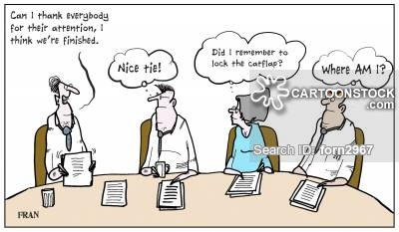
Avoiding Distractions - Meeting
Attend meetings that are relevant to you.
Arrive on time – nether early nor late.
Leave the meeting early if partially relevant.
Notes:
Only attend meetings that are relevant to you. Is the meeting necessary and does it have a specific purpose?
Aim to arrive on time for meetings, neither early nor late.
Know the purpose of the meeting and get a copy of the agenda in advance. Arrange to leave the meeting early if it is only partially relevant.
Agree in advance how long meetings will run for. Start and end the meeting on time.
Use a timed agenda, especially for longer meetings or where the chairperson is less effective

Slide 25
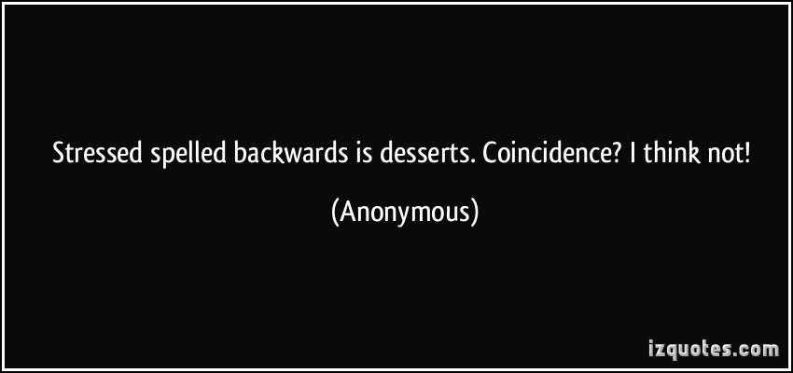
Avoiding Distractions - Stress
Busy → a shorter temper → likely to get irritated → Stress and anger will both potentially waste more time → Risk of damaging your health and damaging relationships
Stay Calm → Let others know when you are busy → Ask them to get back to you later.
Notes:
When we’re busy we are more likely to have a shorter temper than when we are more relaxed. Little things are more likely to irritate us and we’re more likely to feel stressed or angry. Stress and anger will both potentially waste more time – and you run the risk of damaging your health and the feelings of others. Always try to stay as calm as possible, let others know that you are busy and that you need time to complete your tasks. People usually understand and may even offer to help!

Slide 26


ACTIVITY – Paper boat
Notes:
Paper Boat
All you need for this one is some newspaper. Divide your group into teams of 4 to 5 members each. Ask them to select/elect a Team Leader.
Then take all the team leaders out of the training hall and teach them to build a paper boat. To make sure they understood, have each person build their own boat with the small square piece of paper you give them. Before you dismiss your leaders, share these instructions:
I am giving you 4 sheets of paper (the sheets you give them should be rectangular in shape).
Your job is to build 30 boats all of the “Same Size” & “All must stand or should not sink flat when the activity is over.”
Quality (shape, finishing, appearance) and Quantity 40 boats both is important.
Time frame is 15 minutes max from the moment you go to your team.
Now let them complete the task; give them 15 minutes.

